Slide 1
Directional Derivatives and Gradient Vectors

Slide 2
Directional derivatives
The derivative of f in some direction at a point.

Slide 3
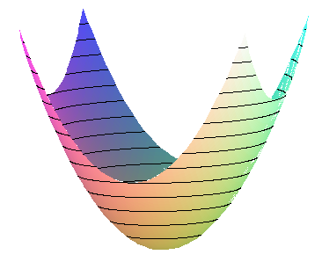
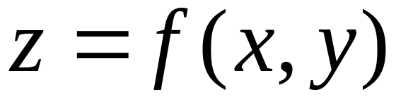
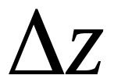
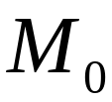



Slide 5
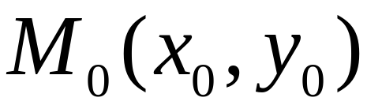
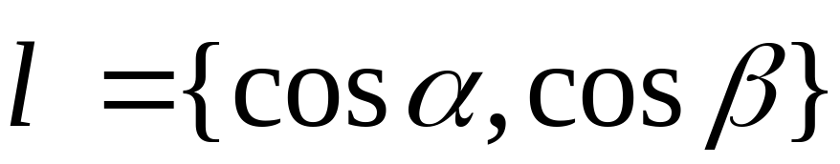
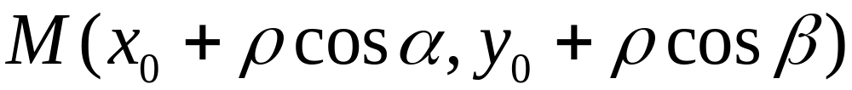
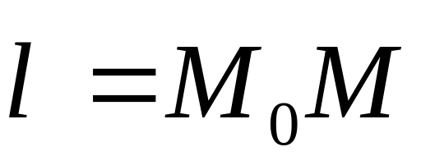


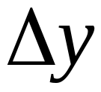
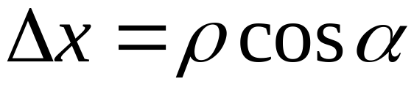

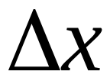
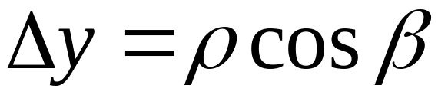

Slide 6
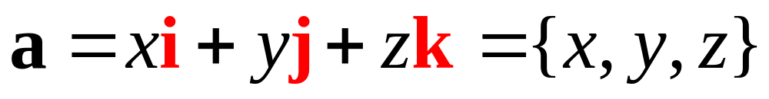
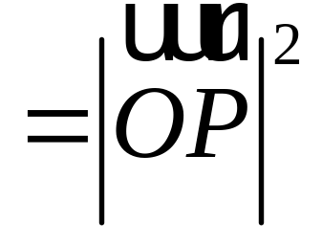
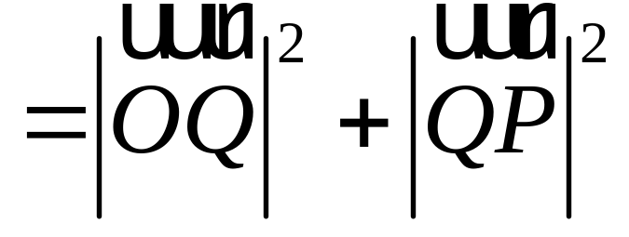

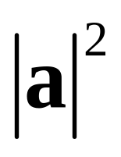

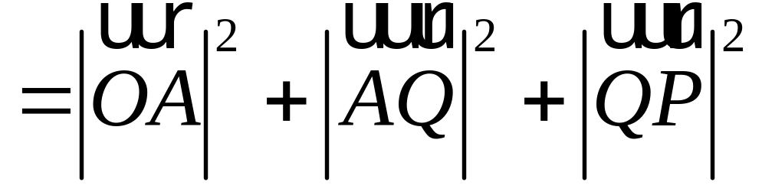
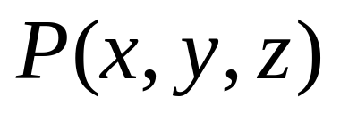

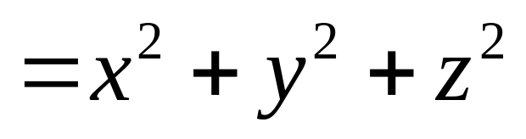






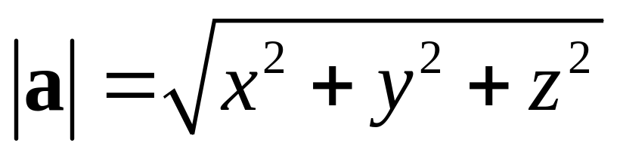

RECALL:
矢量的模的计算公式

Slide 7
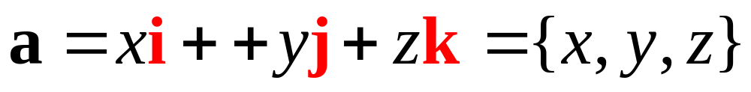
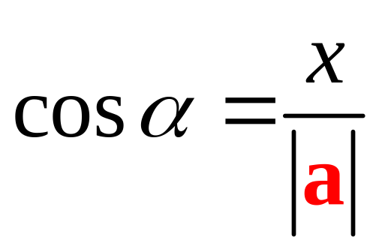
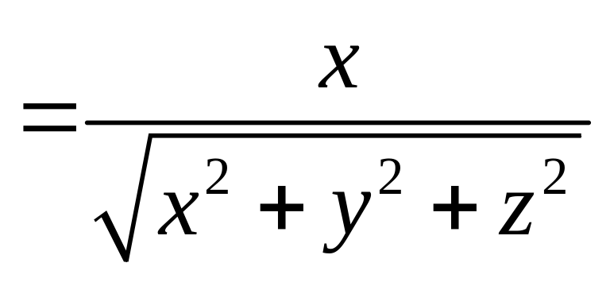
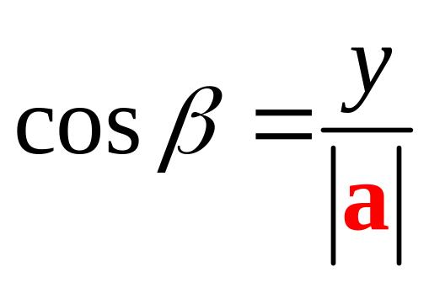
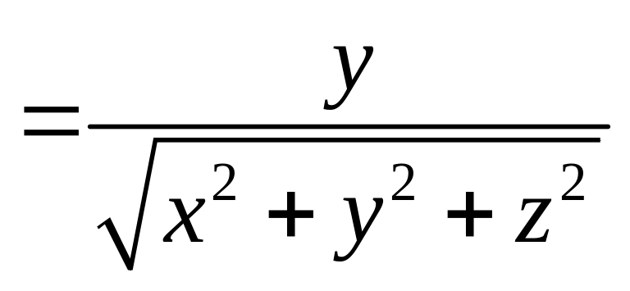
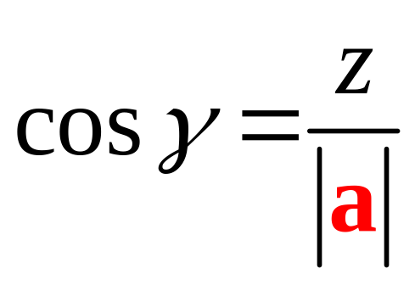
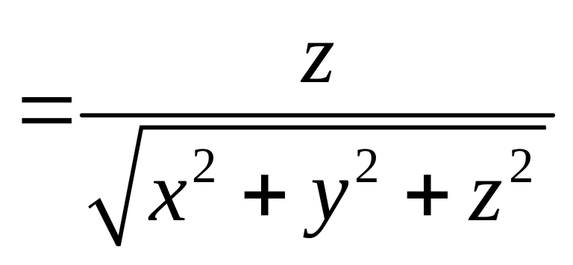
方向余弦

Slide 8
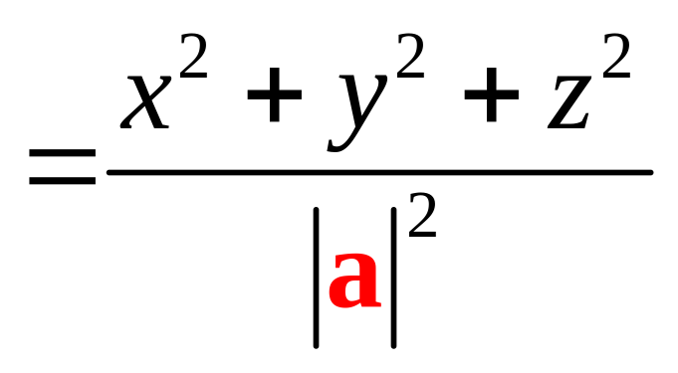
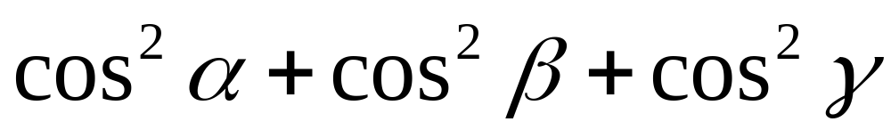
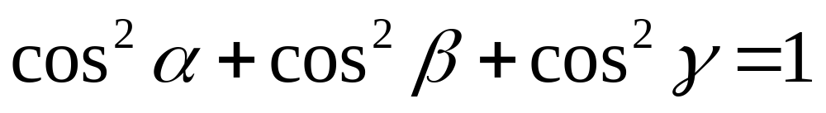
方向余弦的性质direction cosine

Slide 10
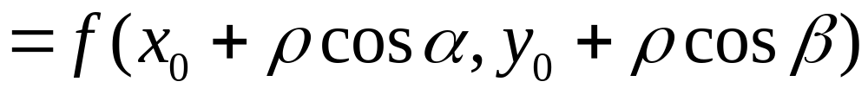
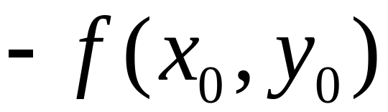
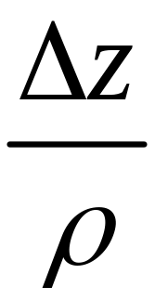
Increment in
：rate of change in

Slide 11
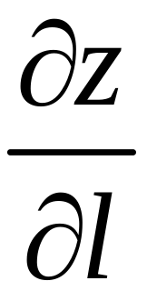
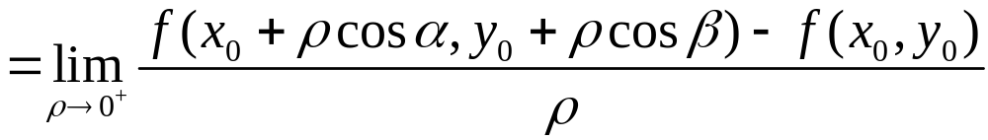
point
in
directional derivative

Slide 12
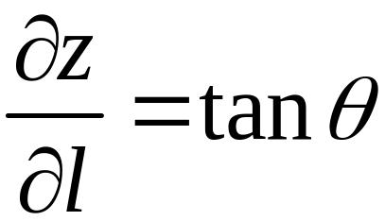


Slide 13
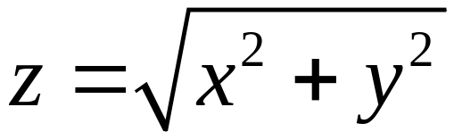
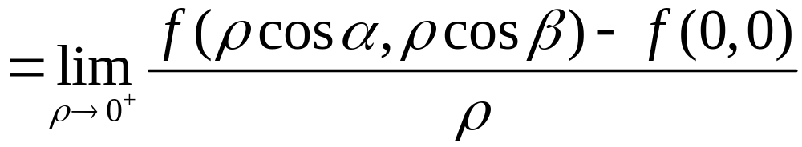
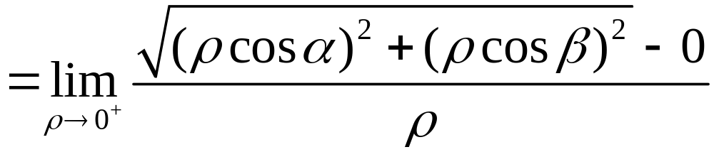
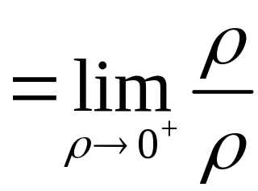

Example
Find
Directional directive at (0,0) in any direction
Solution
If direction is

Slide 14
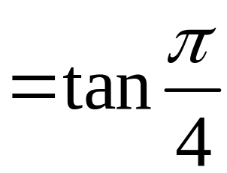
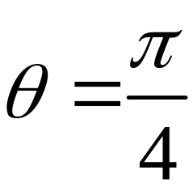
(cone)
The directional directive in any direction is 1
but
The partial directive does not exist

Slide 15
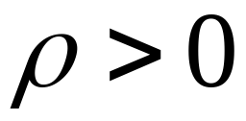
Directional directive is one-sided
The directional directive exists in any direction does not mean that the partial derivatives exist, think of the cone at the vertex

Slide 16
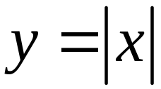
Upper cone
No partials
Not differentiable
No tangent plane there

Slide 17
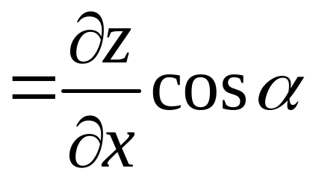
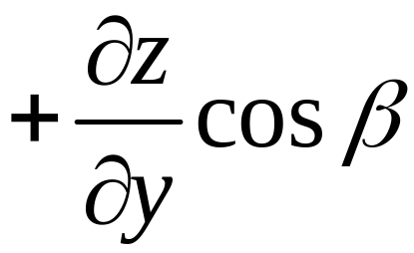
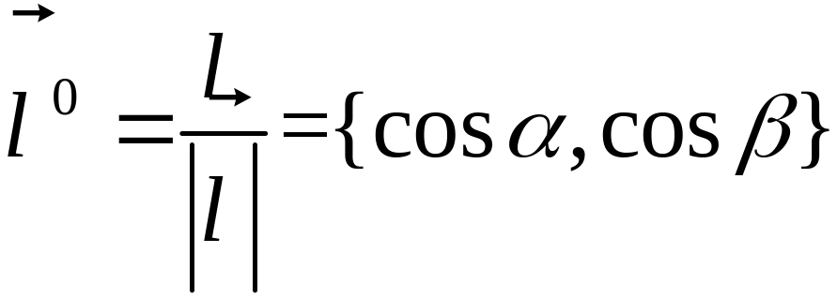
Finding directional derivatives
Theorem If z=f(x,y) differentiable

Slide 18
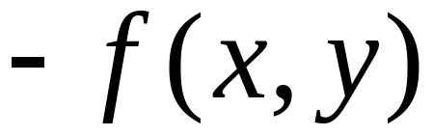
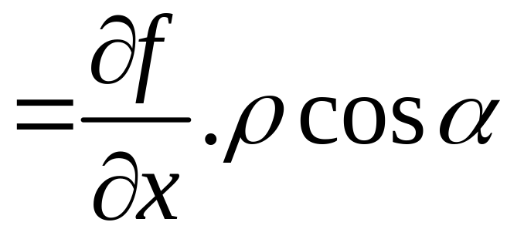
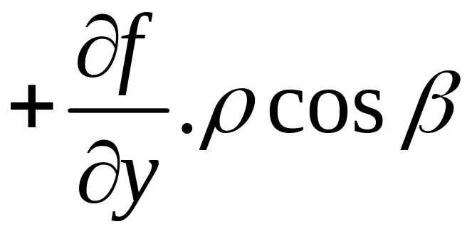




Proof
differentiable

Slide 19


Slide 20






if is not an unit vector then

Slide 21










Slide 22


Geometrical interpretation
is the projection of
on

Slide 23
















Example
Solution

Slide 24









Functions of three variables
at
in the direction
The directional derivative：

Slide 25










Example

Slide 26


Slide 27
Gradient vectors

Slide 29




Slide 30





when
The derivative obtains its maximum
so
is the direction in which the directional derivative attains its maximum

Slide 31


Slide 32




The direction
is the one in which the functions changes fastest
We say the vector
is the gradient vector of at

Slide 33

Gradient is a vector/direction
in which
Changes fastest
The directional derivative is maximum in that direction
The maximum directional derivative is

Slide 34



Let
So, maximum rate of change is

Slide 35



Let
So, maximum rate of change is

Slide 36





Geometric interpretation of the gradient
Level curves
is the normal vector of at

Slide 37








;level curves

Slide 38



Opposite direction
The function goes down up the fastest
gradient
The function goes up the fastest
plot3d(x/(x^2+y^2+1),x=0..4,y=-3..3,contours=15,thickness=3,color=brown);
contourplot(x/(x^2+y^2+1),x=0..4,y=-3..3,contours=15,thickness=3,color=brown);

Slide 39


Level curves are perpendicular to gradient vectors
with(plots):
p1:=contourplot(x/(x^2+y^2+1),x=0..2,y=-2..2,contours=15,thickness=2,color=brown):
p2:=gradplot(x/(x^2+y^2+1),x=0..2,y=-2..2,arrows=thin,thickness=2,color=black):
display(p1,p2);

Slide 40



Example
The temperature at each point (x, y) is
An ant is at M(1, 1), the temperature there is 76. She is dying.

Slide 41



What path she needs to choose to escape ?
Yes, negative of the gradient
If the path is
The tangent vector is ：

Slide 42










but
let
then
so

Slide 43






Since
so
Plug in x = 1, y = 1 to obtain：C = 5
The escaping path is ：
parabola

Slide 44



Graph
Level curves
with(plots):
qumian:=implicitplot3d(z=80-2*x^2-y^2-x,x=-20..20,y=-20..20,z=0..80,style=patchcontour,numpoints=20000):
x_axis:=plot3d([u,0,0],u=-8..8,v=0..0.01,thickness=2):
y_axis:=plot3d([0,u,0],u=-10..10,v=0..0.01,thickness=2):
z_axis:=plot3d([0,0,u],u=0..90,v=0..0.01,thickness=2):
display(qumian,x_axis,y_axis,z_axis,orientation=[23,66]);

Slide 45



Route
Level curves
with(plots):
dengwenxian:=contourplot(80-2*x^2-y^2-x,x=-3..3,y=-3..3,contours=30,color=red): tidu:=gradplot(80-2*x^2-y^2-x,x=-3..3,y=-3..3,color=black,arrows=slim):
paowuxian:=implicitplot(5*y^2=4*x+1,x=-3..3,y=-3..3,color=brown,thickness=3): display(dengwenxian,tidu,paowuxian);

Slide 46











Gradient operator
Also Hamilton Operator

Slide 47








Laplace 算子

Slide 48


